Slide 1
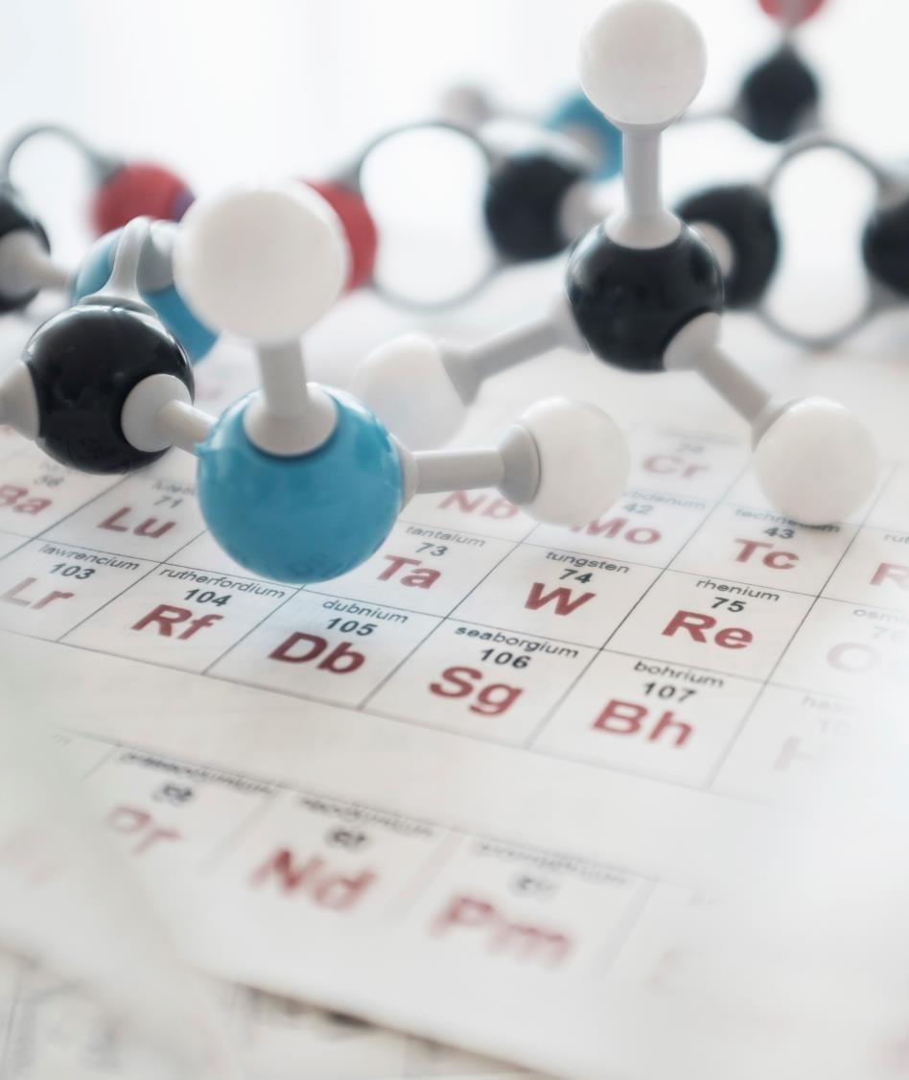
Bioinformatics Research paper Based Presentation

Slide 2
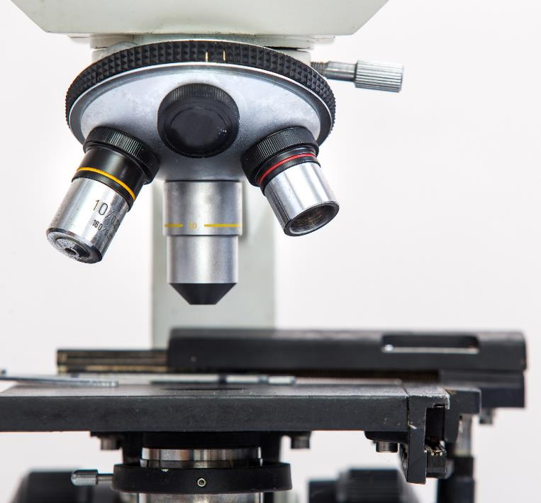
United International University
Introduction To Bioinformatics
Course Code – CSE 493
Name –
Subrota Sarkar , ID – 011 151 144
Trisha Barman , ID- 011 151 131
Ashis kumar Mohanta , id:011153079
Ahsan Habib , id:011133001
Redwan Tanvir Kanon
Section - A

Slide 3
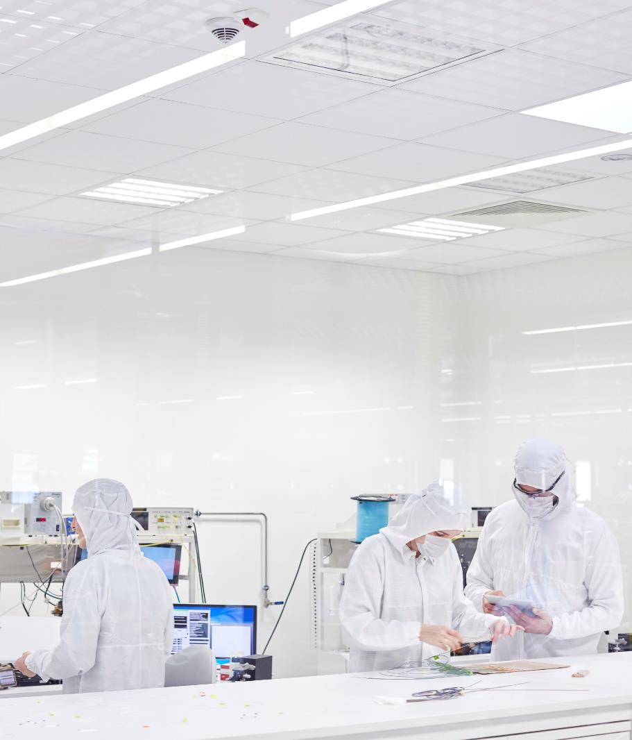
PredCar-site: Carbonylation sites prediction in proteins using support vector machine with resolving data imbalanced issue .
Paper Information :
Department of Computer Science & Engineering, University of Rajshahi , Bangladesh

Slide 4

Motivation -
The experimental technologies are costly and time-consuming to detect the carbonylation sites in proteins.
An accurate computational method for predicting carbonylation sites is an urgent issue which can be useful for drug development.

Slide 5
Main Objective -
In this study, a novel computational tool termed predCar-Site has been developed to predict protein carbonylation sites by –
Incorporating the sequence-coupled information into the general pseudo amino acid composition.
By Different Error Costs method balancing the effect of skewed training dataset.
As a classiﬁer constructing a predictor using support vector machine.

Slide 6
Introduction -
Carbonylation
The carbonylation is found as an irreversible post-translational modiﬁcation and considered a biomarker of oxidative stress. It also associated with some diseases such as Alzheimer's disease, diabetes, chronic renal failure, chronic lung disease and Parkinson's disease.
Carbonylation has been considered as a biomarker for oxidative stress due to its some unique characteristics such as
relatively early formation.
Stability.
Irreversibility.
By The predCar-Site predictor achieves an average AUC (area under curve) score of 0.9959, 0.9999, 1, and 0.9997 in predicting the carbonylation sites of K, P, R, and T.

Slide 7
Problem Statement -
One of the major challenges is to handle imbalance dataset problem as it is found in most of the dataset. For this kind of prediction, the number of negative subset is much larger than the corresponding positive subset. As the real world picture is that the non-carbonylation sites are always the majority compared with the carbonylation ones, so naturally the predictor should be biased to the non-carbonylation sites. Here the problem is that, for this type of predictors may interpret many carbonylation sites as non-carbonylation sites. But, the information about the carbonylation sites is mostly desired than non-carbonylation sites. As a result, it is crucial to ﬁnd an effective solution to balance this kind of bias consequence.
Sequence sample, one of the critical problem in bioinformatics is how to extract vector from biological sequence with keeping considerable sequence characteristics.
Challenge in imbalance problem is that the small classes are often more useful, but standard classiﬁers tend to be weighed down by the huge classes and ignore the tiny ones.

Slide 8
Tools & Model -
For predictor -
support vector machine
features used in this predictor are extracted by
vectorized sequence-coupling model
Data imbalance issue -
the Different Error Costs (DEC) method.
To estimate the skill of machine learning models -
stratiﬁed 10-fold cross-validation.
Implement system –
Matlab 2014

Slide 9
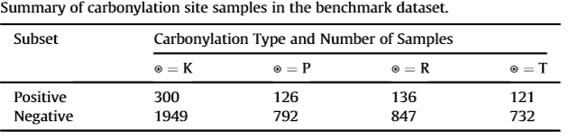
Material and methods -
Benchmark dataset
iCar-PseCp's benchmark dataset set has been used in this study. iCar-PseCp's dataset was derived from the 230 carbonylated protein sequences from human and 20 carbonylated protein sequences from Photobacterium and window size, < 30%.
Summary of this benchmark dataset is –

Slide 10
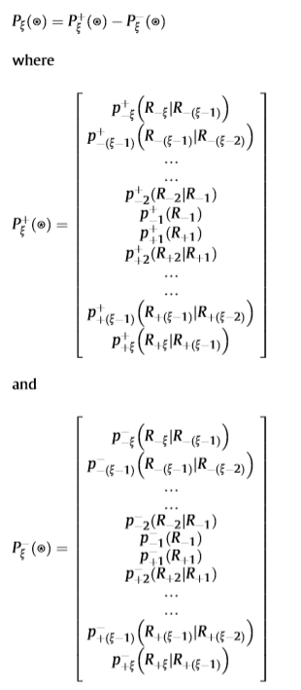
Feature extraction -
In this paper, to avoid completely losing the sequence pattern information of protein, sequence-coupling model has been adopted to extract feature from peptide segment. The peptidesequence of Eq.(1) can be formulated as –
Probability values are derived from the negative benchmark dataset given in Supporting Information S1, S2, S3, and S4, respectively.

Slide 11

SVM classiﬁcation -
Consider the problem of separating the set of training vectors belong to two separate classes, (X1,Y1)(X2,Y2)……(Xn, Yn) where decision function f (x, Ɵ) such that y = f (x, Ɵ), where y is the class label for x and Ɵ is a vector of unknown parameters of the decision function.
In this work, radial basis function (RBF) kernel has been used to build the SVM classiﬁer which is –
Imbalance dataset problem management -
In this paper, we have used a Different Error Costs(DEC)method to handle imbalance dataset problem of carbonylation sites prediction. The Different Error Costs (DEC) method is a cost-sensitive learning solution proposed to overcome the imbalance dataset problem for SVM.

Slide 12
Experimental setting -
In this study, used k-fold cross-validation (subsampling) method to save the computational time.
repeated the 10-fold cross-validation for 5 times.

Slide 13
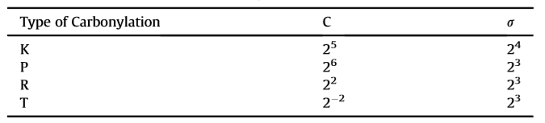
Results and discussion -
Model selection for SVM
In this experiment, grid-search technique has been used to ﬁnd the best model for SVM.
Final Selection of C and Sigma to Train the System for the Web Server.
In this study value of C and sigma which appears most of the times as best model in 5 complete runs of the 10-fold cross-validation to train the system for the web
Carbonylation sites predictions. Apart from the metrics, they have calculated precision too for their system and got the average (±standard deviation) values of 83.19(±0.62)%, 97.52(±0.82)%, 93.95(±1.67)%, and 94.66(±1.19)% in predicting the carbonylation sites for K, P, R and T respectively.

Slide 14
Comparison
Current work
Previous work
To compare the performance of predCar-Site with this systems (PTMPred, CarSpred and iCar-PseCp) use the large number of dataset employing stratiﬁed 10-fold cross-validation.
Performed ﬁve complete runs of the 10-fold-crossvalidation, where each complete run of the 10-fold cross-validation uses a different 10-way splits.
iCar-PseCp's benchmark dataset set has been used.
Probability values are derived from the negative benchmark dataset.
Same as the Current work.
In previous studies Exact 10way splits dataset used.
Probability values are derived from the positive benchmark dataset.

Slide 15
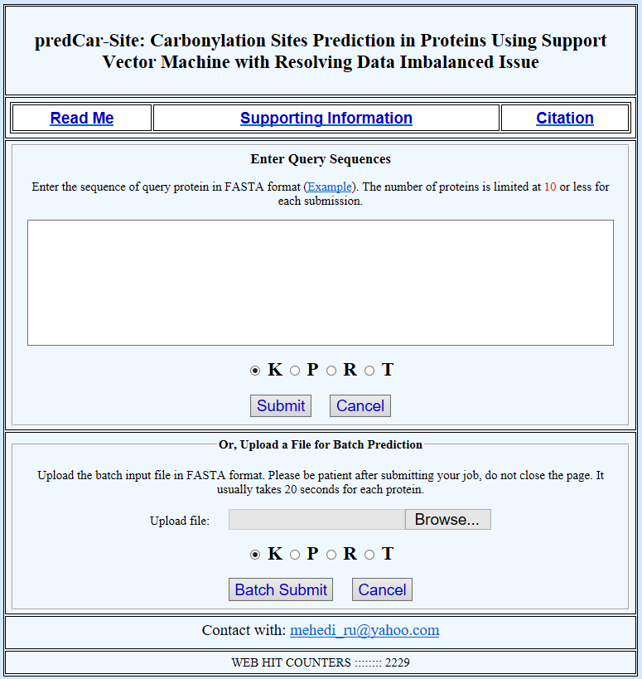
Large image
Webserver for PredCar-Site

Slide 16
Conclusion -
In this article, designed a simple and efﬁcient predictor predCar-Site for predicting carbonylation sites.
Experimental results show that their method is very promising and can be a useful tool for prediction of carbonylation sites.
The predCar-Site has achieved remarkably higher success rates in comparison with the existing predictors.
Established a user-friendly webserver and provided a step-by-step guide for the convenience of the experimental scientists. It provides as easier way to obtain the desired results without knowing the mathematical details.

Slide 17
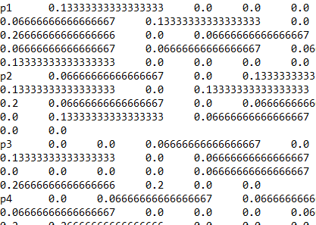
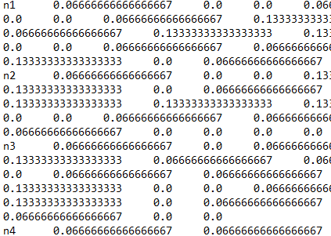
Feature extraction:

Slide 18
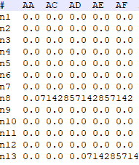
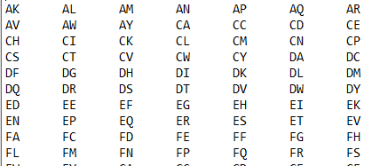
Feature extraction:

Slide 19
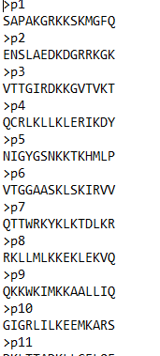
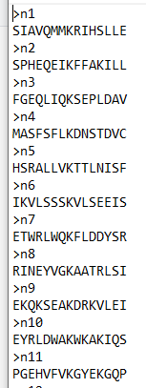
Output:

Slide 20
Thank You

